Slide 1
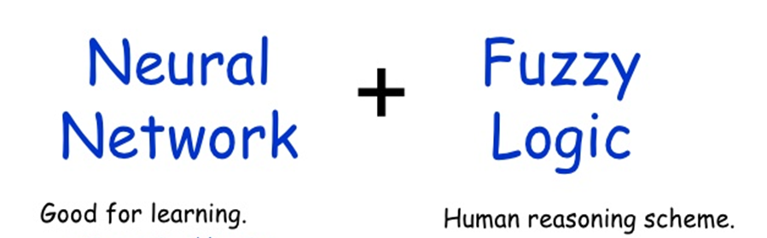
NEURAL NETWORKS
AND
FUZZY LOGIC
(NNFL)
( BITS F312)
AUG-DEC-2020

Slide 2
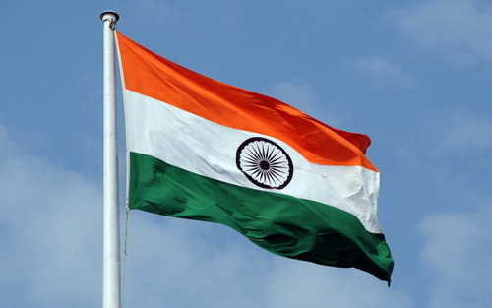
“Long years ago, we made a tryst with destiny and now the time comes when we fulfil it, not wholly or fully but very sustainably.
At the stroke of the midnight hour, when the world sleeps, India shall awake to life and freedom.”
JawaharLal nehru
our struggle for freedom continues
It is time to look within and recognise our continued slavery---That which we allow in our belief systems and attitudes

Slide 3

First Time
First class of NNFL On-line
Your enthusiastic, sprightly ways,
full attendance, atleast in few classes in beginning of semester !

Slide 4
INTRODUCTORY LECTURES
Introduction of teachers
Course content
Evaluation Scheme
Guidelines for students
Learning material- books, websites, journals
AI influencers, experts and thought leaders
Skills for AI/ML: concepts/software/hardware
Data – the fuel in AI engine
AI is Real, AI- Eclectic perspective

Slide 5

Please keep your notebook and Pen ready to write KEY WORDS

Slide 6
Make sure there are no distractions when you are about to watch an online lecture.
Focus on keywords of a lecture, make shorthand notes - write important terms, concepts covered in each class,
After classes are over for a day or on weekend consolidate the notes in another notebook with help of recorded lectures and other resource material.

Slide 7
Introduction of Teachers
Surekha Bhanot
&
Bijoy Krishna Mukherjee(IC)

Slide 8
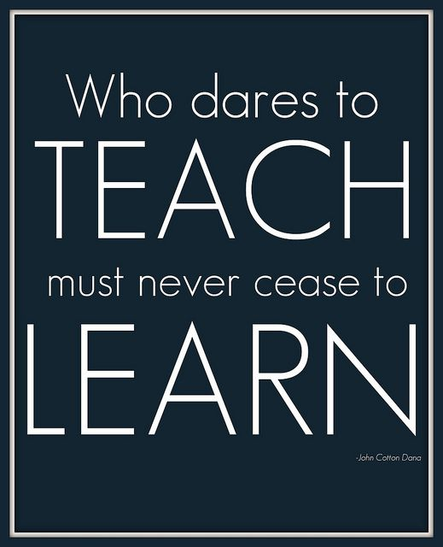

Slide 9
Myself : SUREKHA BHANOT
1974-79 B.E.(Mech) BITS Pilani
1979-83 Masters(Instrumentation) + Teaching at BITS Pilani
1983-2002 Teaching at Thapar University, Patiala + IIT Roorkee (Phd 1990-94)
2002- EEE Dept BITS, Pilani Warden, Meera Bhawan
Chamber No. 2135
Email : surekha@pilani.bits-pilani.ac.in
Research Interests :
AI applications in Measurements, Process modeling & control, bio-medical

Slide 10
Bijoy Krishna Mukherjee (IC)
Education: Ph.D. (Flight Control, IIT Kharagpur, 2017)
M.E. (Control Systems, IIEST Shibpur, 2004)
B.E. (Electrical, North Bengal University, 2002)
Experience: Sr. Asstt. Prof., SASTRA University, (0.5 yr.)
Asstt. Prof., Asansol Engg. College,WB (6.5 yr)
Project Fellow, IIEST Shibpur (1.0 yr.)
Joined EEE Department, BITS Pilani on July 2, 2018
Email : <bijoy.mukherjee@pilani.bits-pilani.ac.in>
Areas of Interest: Control Systems
Flight Dynamics
Estimation Theory

Slide 11
COURSE CONTENT
Introduction to AI & Intelligent systems 2-3 L
Evolutionary optimizing techniques 5-6 L
Fundamentals of Artificial Neural Networks (ANNs) & Applications 22-23 L
Fundamentals of Fuzzy Logic & Applications 6-7 L
Hybrid Intelligent System[ Optimized Neuro-Fuzzy 2-3 L

Slide 12


Slide 13
EVALUATION COMPONENTS
Component | Marks | Duration | Dates
T1 | 45 | 30 min | September 10 –September 20 (During scheduled class hour)
T2 | 45 | 30 min | October 09 –October 20 (During scheduled class hour)
T3 | 30 | 30 min | November 10 – November 20 (During scheduled class hour)
Compre | 90 | 120 min | Dec. 11
Assgn. Coding | 30 |  | Over by mid Oct
Assgn. Research Paper | 60 |  | Over by Nov end

Slide 14
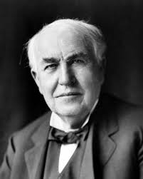
Assignment is an opportunity for SELF-LEARNING
Thomas A Edison
"Opportunity is missed by most people because it comes dressed in overalls and looks like work."

Slide 15
ASSIGNMENTS :
One /Two coding submissions [30 M] Individual
2. Design/Development/Implementation/ Improvisation of research paper(s)
[60M- coding + presentation + viva ]
Group of 3
Assignment 1&2 require using framework & libraries like (numpy, keras,fastai, PyTorch, and TensorFlow,matplotlib/pandas( best tool available for importing and managing datasets)

Slide 16
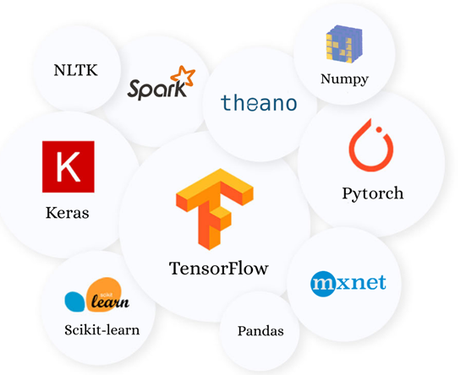
Workshops would be conducted by student TAs.
Tensorflow by Google Brain , is publically available to the ML community for testing and modifications.

Slide 17
Colab is a free Jupyter notebook environment that runs entirely in the cloud.
As a programmer, Colab Offers You
Write and execute code in Python
Document your code that supports mathematical equations
Create/Upload/Share notebooks
Import/Save notebooks from/to Google Drive
Import/Publish notebooks from GitHub
Import external datasets e.g. from Kaggle
Integrate PyTorch, TensorFlow, Keras, OpenCV
Free Cloud service with free GPU

Slide 18
Purpose of Assignments :
Learning the skill of Reading, Understanding and Interpreting Research Publications
Generating Creative / Innovative ideas
Creativity and imagination, combined with rigor and discipline is the hallmark of an engineering/science student
Learn art of documenting research work

Slide 19
TOPICS of research papers in Assgn 2:
Fuzzy logic : Theory and applications in household appliances/transportation systems/ Irrigation systems/Financial systems/Industrial systems/Aviation systems/Pattern Recognition systems
ANN : Theory and applications in Medical diagnosis /Modeling/Speech recognition/NLP/ Face recognition /Pattern Recognition /Games/ industrial control system
Hybrid + GA/PSO/DE/ optimization Theory and practice : Fuzzy controller, Neuro controller/ Neuro-Fuzzy controller

Slide 20
Questions To Ask Yourself to ensure understanding of research papers Andrew NG
Describe what the authors of the paper aim to accomplish
If a new approach/technique/method was introduced in a paper, what are the key elements of the newly proposed approach?
What content within the paper is useful to you?
What other references do you want to follow?

Slide 21
Achieving a research-level understanding of most topics is like climbing a mountain.
Aspiring researchers must struggle to understand vast bodies of work that came before them, to learn techniques, and to gain intuition.
Upon reaching the top, the new researcher begins doing novel work, throwing new stones onto the top of the mountain and making it a little taller for whoever comes next. Chris Olah

Slide 22
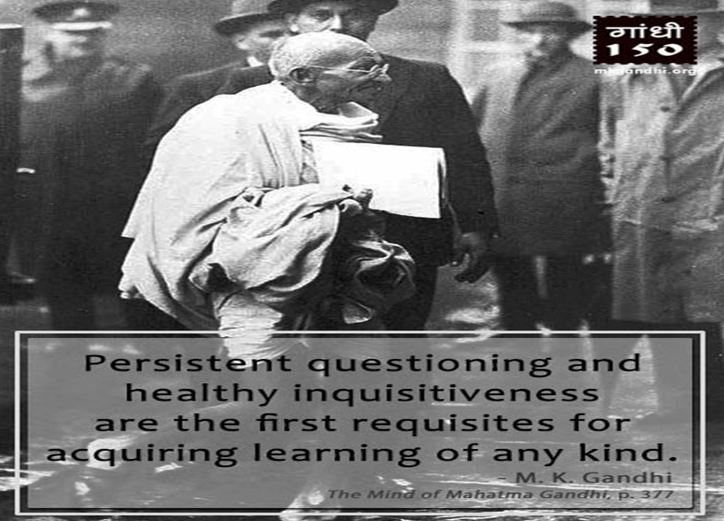
Responsibilities of Students

Slide 23
Learning is not attained by chance, it must be sought for with ardor and attended to with diligence.
Mail Suggestions/queries/questions regarding lectures/assignments/tests.
Follow email etiquettes, interact in noble, dignified manner.
Will post answers on Nalanda/Google classroom for benefit of all.

Slide 24
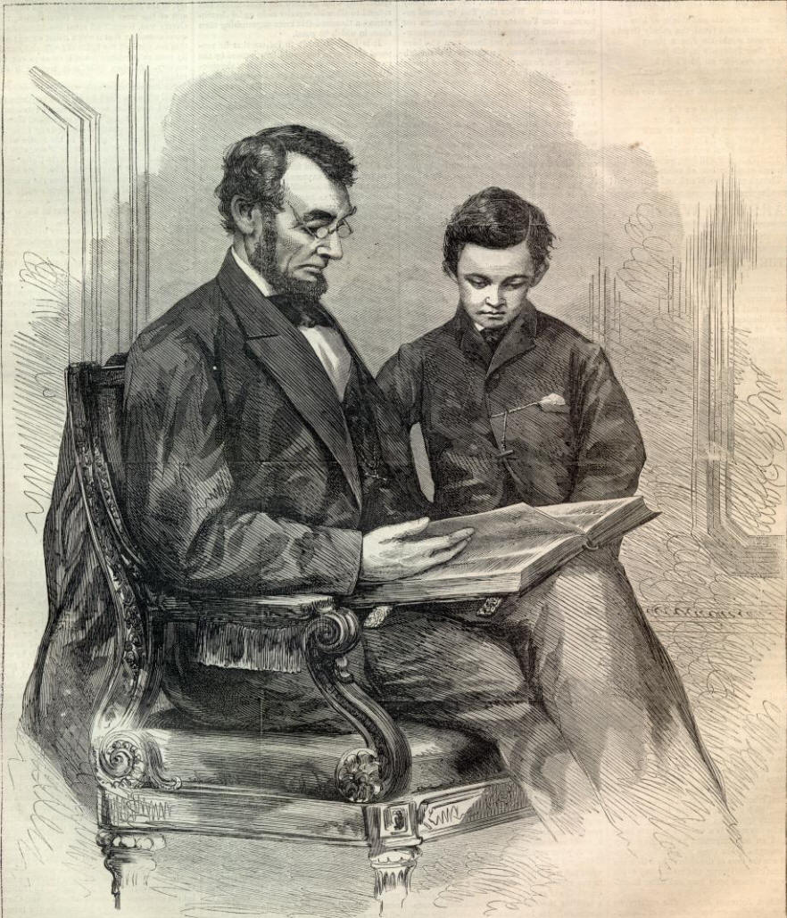
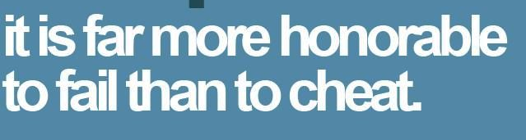
Academic honesty and academic integrity are to be maintained, in tests, quizzes & assignments

Slide 25


Slide 26
Learning Materials
There is no single text book..
MUST read
good Books/Blogs/Research papers to supplement your understanding
You will have recordings of lectures after the class.

Slide 27
BOOKS:
Neural Networks and Learning Machines Simon Haykin
Neural Networks and Deep Learning Michael Nielsen http://neuralnetworksanddeeplearning.com
Artificial Neural Networks
B Yegnanarayana, (IITM)
Intelligent Systems and Control
Laxmidhar Behera , Indrani Kar (IIT kanpur)
Neural Network Design,Martin D Hagen et al
Machine Learning by Tom M. Mitchell`

Slide 28
A first course in Fuzzy and Neural Control, By Hung T Nguyen et al, Chapman & Hall/CRC Press Company
Fundamentals of Neural networks, architecture, algorithms and applications, Laurene Fausett, Pearson Education
Deep Learning by Yoshua Bengio, Ian Goodfellow and Aaron Courville

Slide 29
Fuzzy Logic with engineering application, Timothy J Ross
Nature-inspired metaheuristc algorithms, Xin-She Yang
Introduction to Soft Computing , Samir Roy, Udit Chakraborty
Soft Computing-Fundamentals and Applications, Dilip K. Pratihar
Engineering Optimization, S.S. Rao

Slide 30
INNUMERABLE CONTENT ON INTERNET :
ocw.mit.com, nptel via Swayam, coursera, edx, udemy
slides, video lectures, blogs, quora, medium daily digest
pdfs of BOOKS
U tube channels : Kaggle, Leo Isikdogan
Yannic Kilcher, ArXiv Insights, Henry AI Labs

Slide 31
Few very popular courses on internet ..
CS229 : Machine learning
CS224d: Deep Learning for Natural Language Processing
CS224n: Natural Language Processing with Deep Learning
CS231n - Convolutional Neural Networks for Visual
Recognition
all the course material is provided for free
and all the lectures are recorded and uploaded on Youtube.
CMU videos on ML by Prof Mitchell

Slide 32
JOURNALS AND MAGAZINES
In area of topics covered in NNFL

Slide 33
International Journal of Intelligent Systems from Wiley
IEEE Transactions on Pattern Analysis and Machine Intelligence
IEEE Transactions on Neural Networks and Learning Systems
IEEE Transactions on Computational Intelligence and AI in Games
Look for REVIEW articles in journals of repute by eminent personalities in the field to get overall picture- past, present & future

Slide 34
Review Articles
are peer-reviewed and give an overview of recent progress in important fields of research, providing the readers with a guide to the relevant literature, an appreciation of the significance of the work, and an outlook into potential future directions.
It is not intended that Review Articles are necessarily comprehensive, but rather insightful, selective, critical, opinionated, and even visionary.
The reference list should be well-balanced. Unpublished results should not be included.

Slide 35
Fuzzy Sets and Systems from Elsevier.
IEEE Transactions on Fuzzy Systems
Fuzzy Information and Engineering from Elsevier.
Fuzzy Optimization and Decision Making, Springer-Verlag.
,
Soft Computing from Springer-Verlag.
IEEE Intelligent Systems

Slide 36
FEW REPUTED CONFERENCES :
CVPR : IEEE Conference on Computer Vision and Pattern Recognition(CVPR)
ECCV ( European Conference on Computer Vision)
ICML (International conference on machine Learning)
NIPS (Neural Information Processing Systems )
NAACL (North America Association of Computational Linguistics)

Slide 37
Influencers, experts and thought leaders..
known for their seminal contributions in the field of AI & Machine learning( ML)

Slide 38
SI Units in fields of Electricity & Magnetism?
Farad, Tesla, Weber, Watt, Hertz, Ohm, Ampere, Joules, Gauss, Maxwell, Coulomb, Volt, Henry
All named after the scientist who discovered these phenomena in 18th , 19th, early 20th century, mostly European, Henry( only american)
In field of AI&ML founders/leaders are alive, young, field is continuously evolving
We know them through their publications, presentations,blogs ,answers on Quora

Slide 39
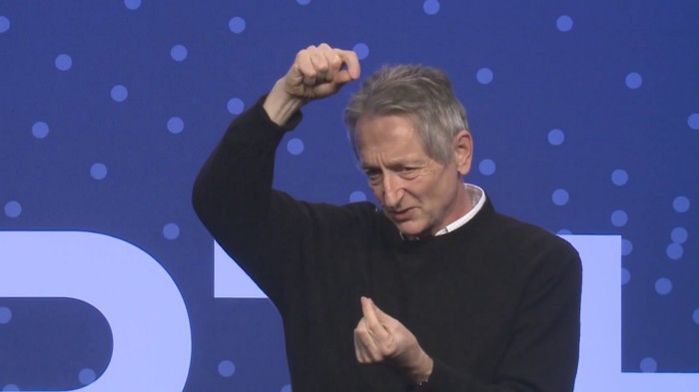
“ future depends on some graduate student who is deeply suspicious about everything i’ve said” Geoffery Hinton, Semantic Scholar

Slide 40
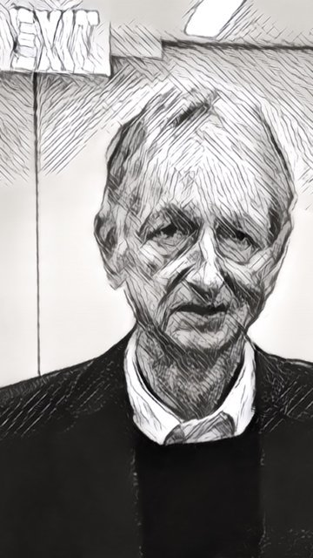
One of the researchers who introduced the back-propagation algorithm
Rectified linear unit (ReLU), -
Currently the most popular activation function for ANNs was first proposed by Nair & Hinton, 2010
Geoffrey E. Hinton- Godfather of AI
Google, University of Toronto

Slide 41
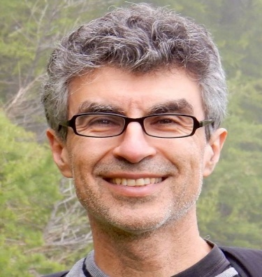
Yoshua Bengio : Professor Department of Computer Science and Operations Research, University of Montreal, Head of the Montreal Institute for Learning Algorithms (MILA)
Famous paper: Learning Deep Architectures for AI, 2009

Slide 42
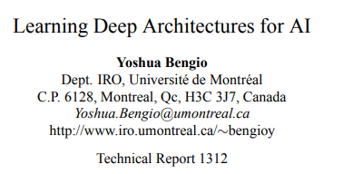
https://www.iro.umontreal.ca/~lisa/pointeurs/TR1312.pdf
56 pages, 2019

Slide 43


Slide 44
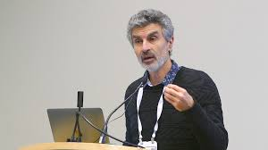
Deep learning involves teaching a machine to perform a complex task using large amounts of data along with a large simulated neural network.
Deep learning is a form of representation learning, where the features of the model are automatically discovered from the data

Slide 45
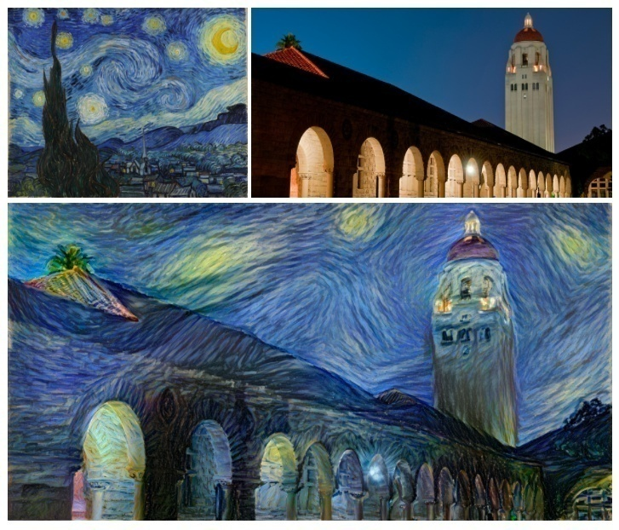
Applications of DL :
Colorization of Black and White Images
Adding Sounds To Silent Movies
Automatic Machine Translation
Object Classification in Photographs
Image Caption Generation
Automatic Game Playing( AlphaGo, AlphaZero etc.)

Slide 46
Last class we discussed
Course contents
Evaluation scheme
Guidelines for students
Learning Material
AI leaders :
Geoffery Hinton–Godfather of AI, famous for
BPA, ReLU
Yoshu Bengio, famous for
Deep Learning architectures

Slide 47
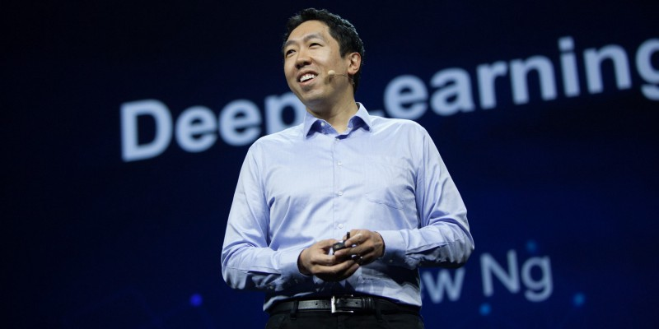
One of the top minds in AI

Slide 48
Co-Chairman and Co-Founder of Coursera
His Machine Learning MOOCs (Massively Open Online Course) is the best course known to date!
Over 2.5 million students
Adjunct Professor at Stanford University.
After his tenure as chief scientist at Baidu, Andrew Ng, has set up
Deeplearning.ai: an education startup ,
AI Fund: for backing artificial intelligence startups
Landing.ai: empower your company to become an AI-driven organization (especially manufacturing)

Slide 49
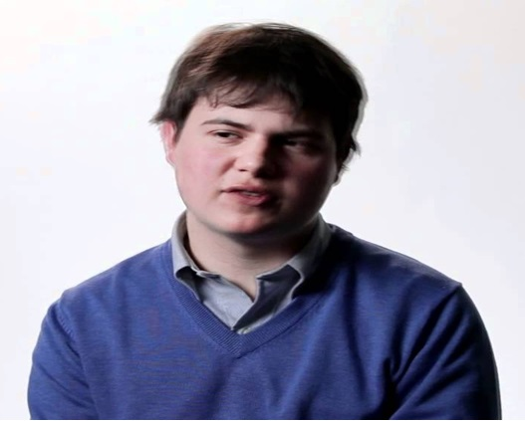
Christopher Olah
Olah’s blog, colah.github.io
The blog succeeds at efficiently explaining some of the most convoluted material in the field.
It also has some of the most beautiful machine learning diagrams on the web.

Slide 50
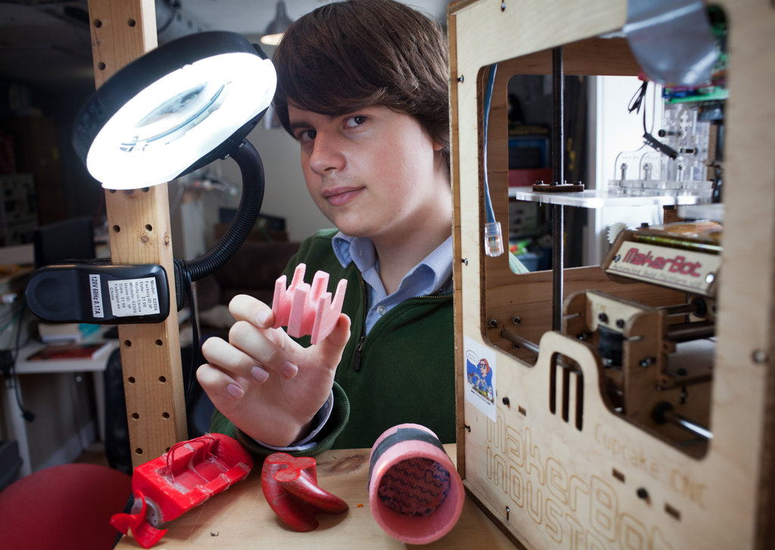
Christopher Olah, 19,Thiel Fellow 2012 with a 3-D printer and printed objects he designed.

Slide 51
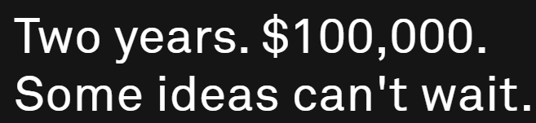
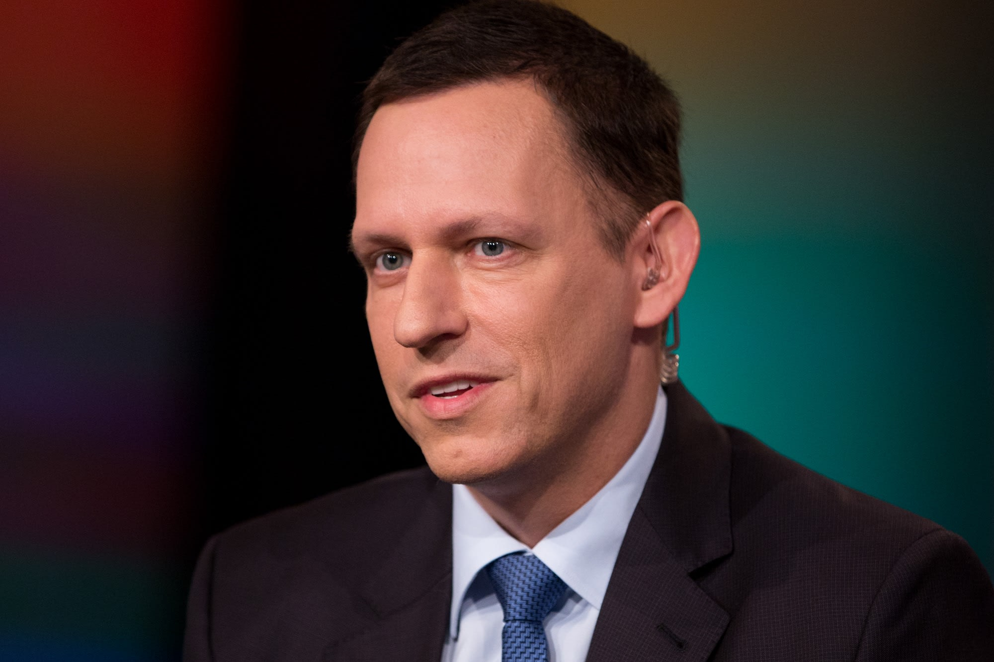
Thiel offers budding entrepreneurs the chance to win the fellowship , if only they drop out of college.

Slide 52
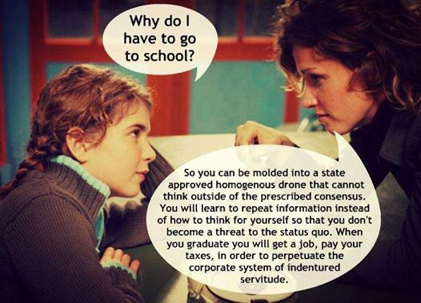
Indentured: A legal agreement, contract, or document

Slide 53
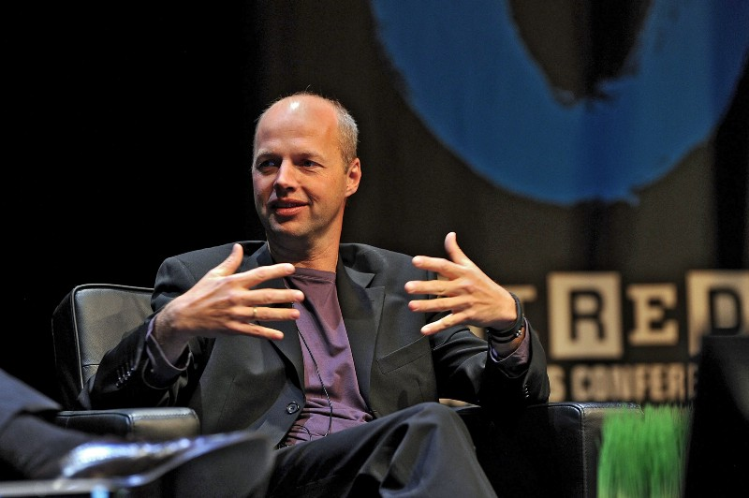
Sebastian Thrun
Stanford Professor
co-founder and chairman of a MOOC, Udacity (a tad (little) more difficult than Coursera’s.)
CEO of the Kitty Hawk Corporation,
founder Google X and Google’s self driving car .

Slide 54

Kok-Leong Seow has worked on creating quantum neural networks and is the creator of KSEOW.com, a leading website that teaches machine learning intuitively in
“tells a story”style
“weird imagery/analogy” way

Slide 55
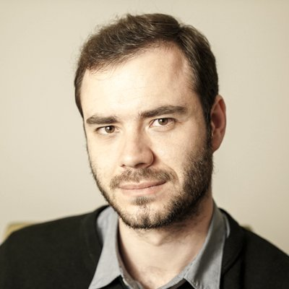
Andrej Karpathy director of AI at Tesla.
Andrej’s blog, karpathy.github.i0, provides good insights on niche subjects in machine learning.

Slide 56
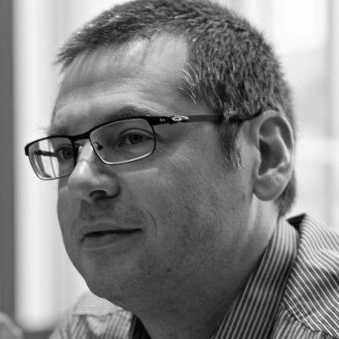
Aaron Courville
Deptt of Computer Science and Operations Research University of Montreal,
Member of MILA (Montreal Institute for Learning Algorithms).

Slide 57
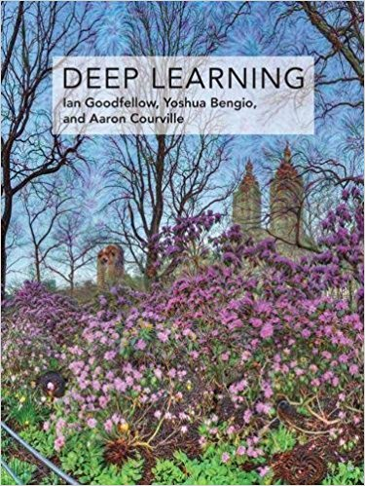

Slide 58

Director of Machine learning in Apple Inc.
Ian Goodfellow is best known for inventing Generative Adversial Networks (GANs)
In 2014 Ian Goodfellow came up with a genius idea to let two adversary networks play a game
Ian Goodfellow

Slide 59
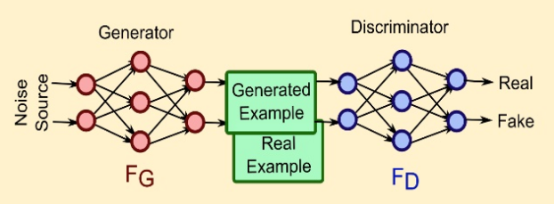
One network-the generator, tries to generate fake data to fool the second network- the discriminator, into “thinking” that the fake data is real while the discriminator tries it's best to tell the fake from the real.

Slide 60
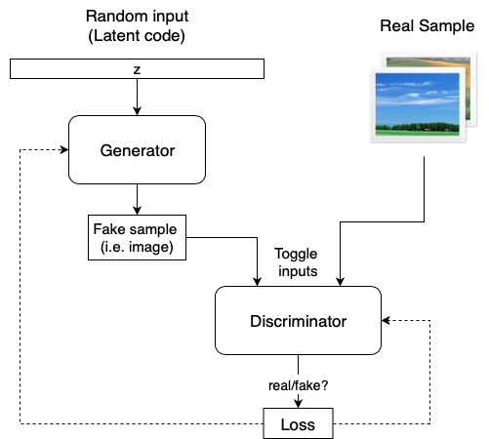
There are now many variants of GANs

Slide 61
The fundamental nature of these dual networks is to outplay each other.
One generates images to fool the other while the other tries not to be fooled.
Given enough time, the network becomes so good that it ends up making fake images as realistic as possible.

Slide 62
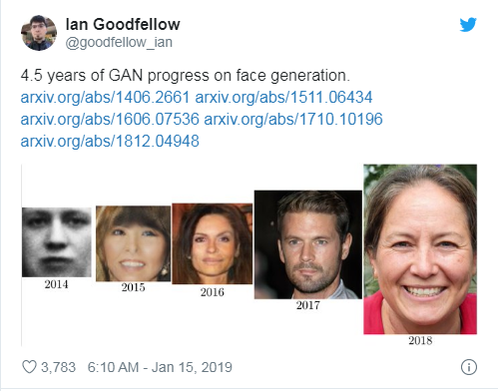

Slide 63
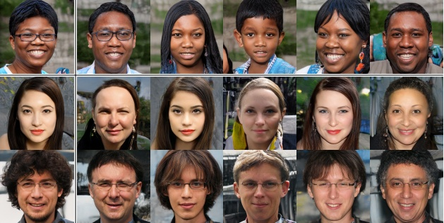
Can you guess what’s common among all the faces in this image?
None of these people are real! These faces were generated by a computer vision technique called GANs

Slide 64
GANs are now ubiquitous.
Data scientists and deep learning researchers use this technique to
Generate photorealistic images
Text to image
Change facial expressions
Create computer game scenes
Visualize designs
Converting black and white imagery to color
Generate awe-inspiring artwork!

Slide 65
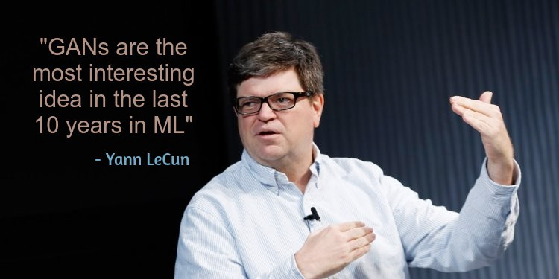
Vice President, Chief AI Scientist at Facebook

Slide 66
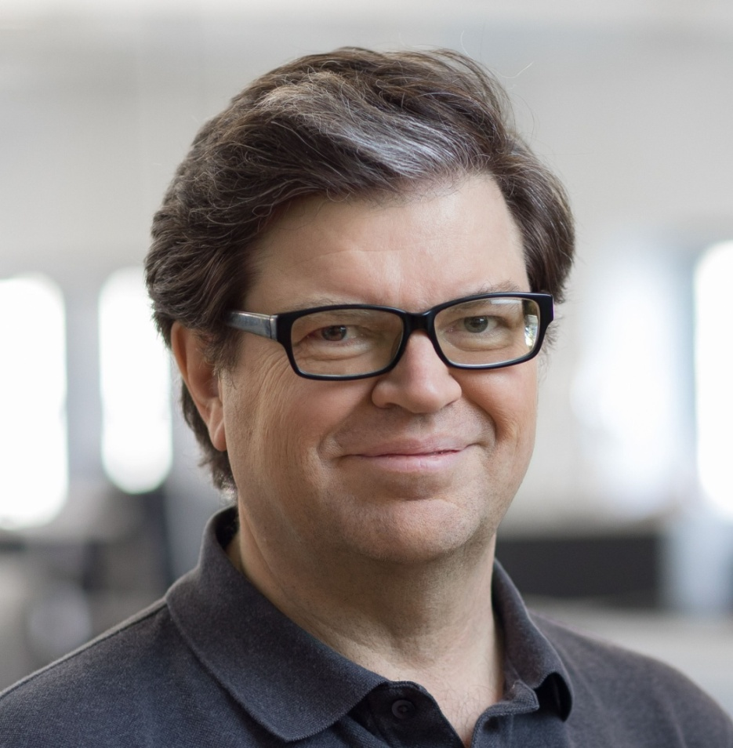
Director of AI Research at Facebook
Professor at NYU
In 1995, Yann LeCun and Yoshua Bengio introduced the concept of Convolutional Neural Networks(CNNs)– a type of ANN which helps in extremely precise image recognition.
Yann LeCun

Slide 67
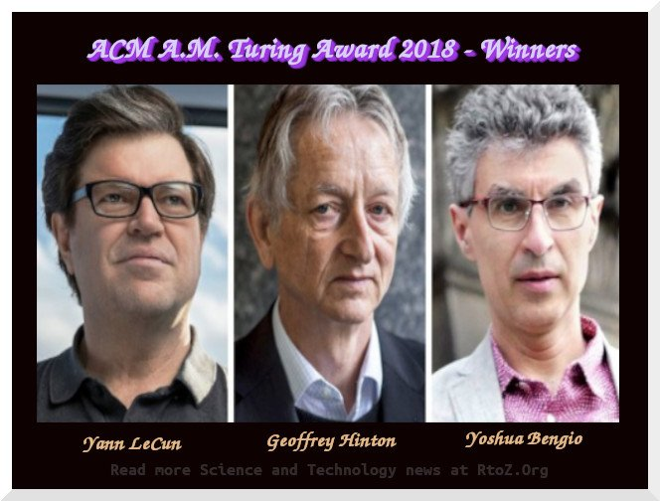
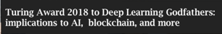

Slide 68
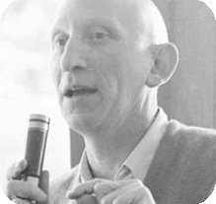
A.M. Turing Award is an annual prize given by the Association for Computing Machinery (ACM)
Recognized as the highest distinction in computer science
Nobel Prize of computing.
First Turing Award to Alan J Perlis, 1966
For his influence in the area of
Advanced programming techniques and compiler construction.

Slide 69
Alan Turing
the father of computer science and artificial intelligence who broke Adolf Hitler's Enigma code system in World War II
— but who died an outcast because of his homosexuality — will be featured on the Bank of England's new 50-pound note in 2021.
A British pioneering computer scientist, mathematician, logician, cryptanalyst, philosopher, mathematical biologist, and marathon and ultra distance runner.
Movie IMITATION based on his life.
a book about Turing titled The Man Who Knew Too Much by David Leavitt
An ultra-marathon is any race longer than the classic marathon distance of 26.2 miles(42.195 km)

Slide 70
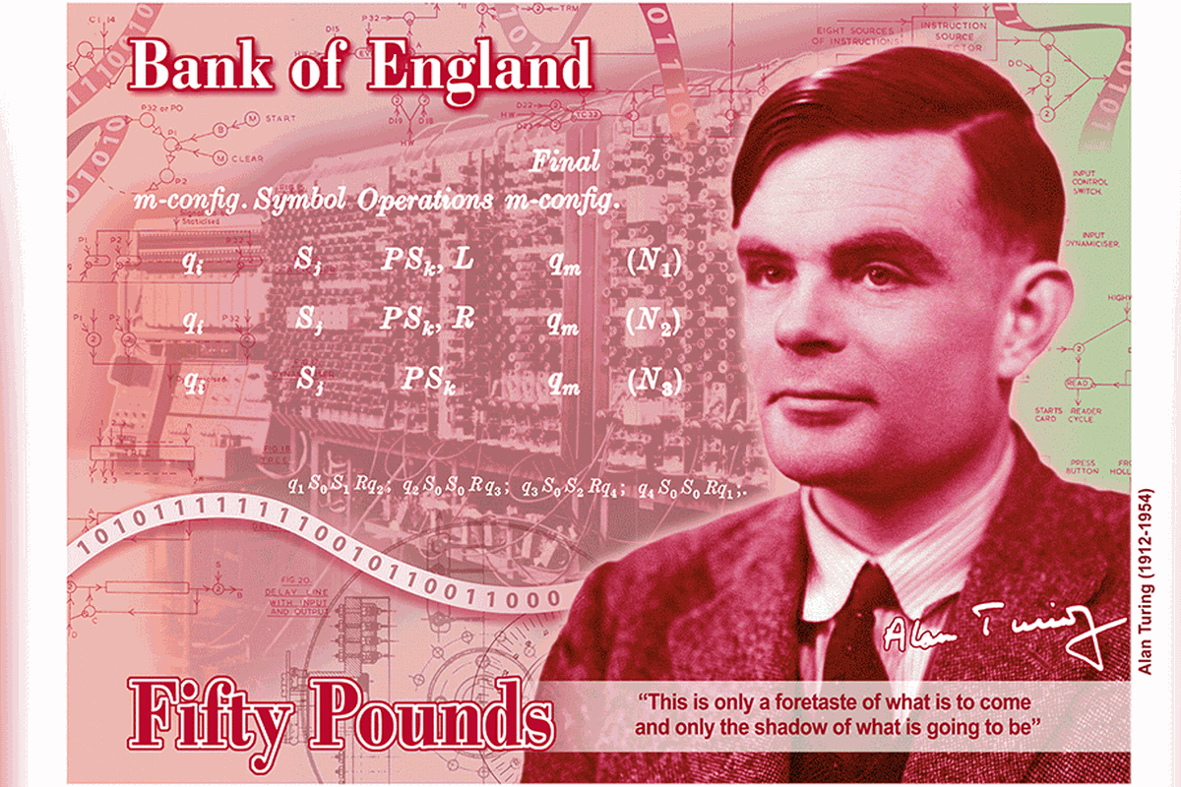
In June 1949 “The Times” of London published an article about a Manchester University project which built an “electronic calculator” referred to hyperbolically as a “mechanical mind”.
Alan Turing said about the device : This is only a foretaste of what is to come and only the shadow of what is going to be”

Slide 71
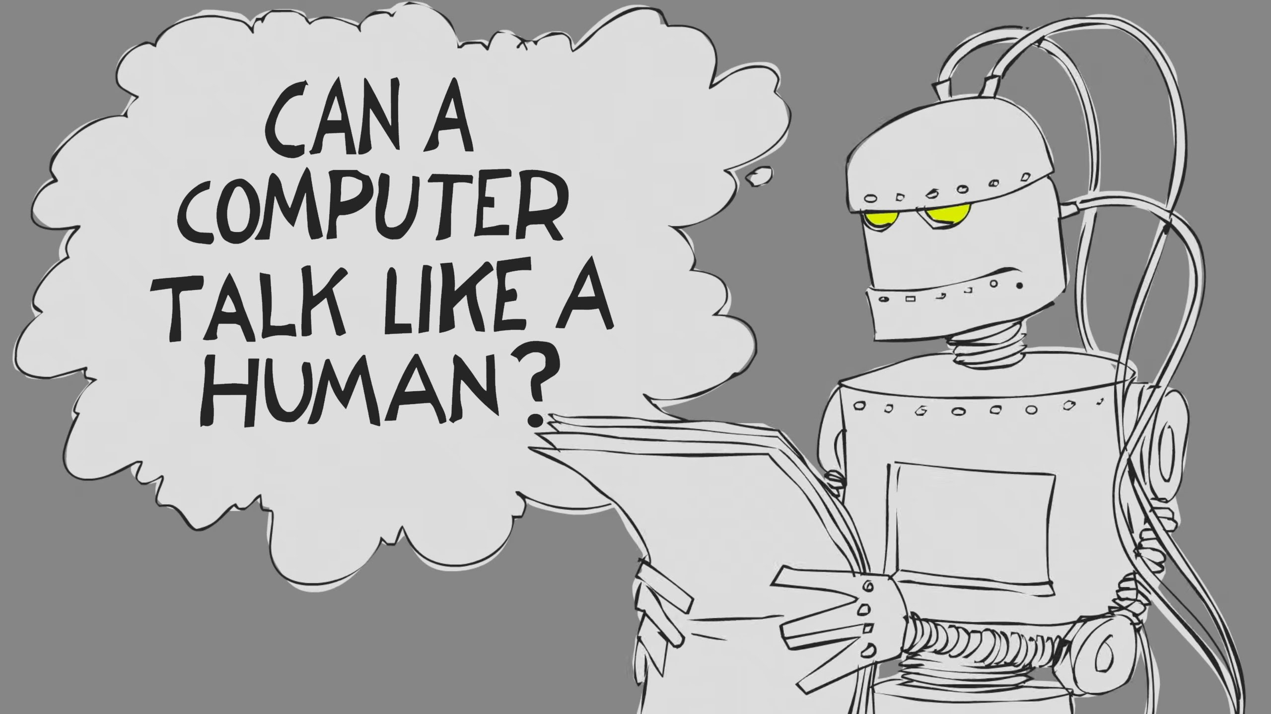

Slide 72
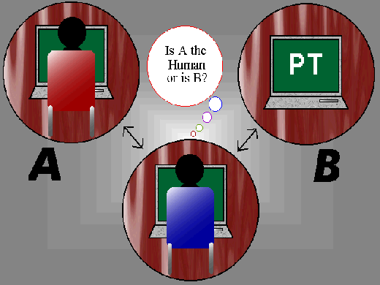
Can a computer convince a human interrogator that it is a human?
For decades, the litmus test of choice was the Turing Test, developed in 1950

Slide 73
Original Turing test only tested whether verbal ability of a computer is indistinguishable from a person’s verbal behaviour The Total Turing Test Includes two more issues:
Computer vision
to perceive objects (seeing)
Robotics
to move objects (acting)

Slide 74
Fields of Study related to AI/ Machine Learning

Slide 75
Control theory
Statistics
Information theory
Mathematical optimization and modeling
Graph theory
Computer graphics
Cognitive science, psychology
Programming language
Robotics
software engineering, etc.

Slide 76
Do NOT run from math.
You math arsenal :
Linear Algebra
Probability , Statistics
Differential Equations
Calculus

Slide 77
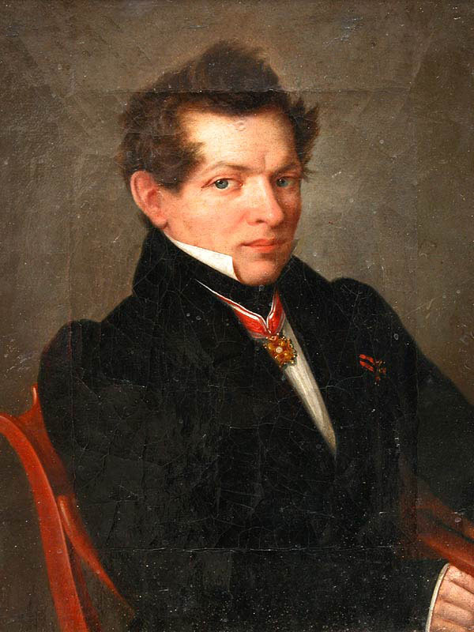
“There is no branch of mathematics, however abstract, which may not some day be applied to phenomena of the real world.”
Nikolai Lobachevsky
(1792- 1856) Russian mathematician and founder of non-Euclidean geometry

Slide 78
Mail from Neel Choksi (B4A8) , 2018 passout,
Univ of Toronto, Canada, Specialization in Photonics
My supervisor always encourages me to find a physical intuition behind any math equation or experimental result, which is great as in BITS, since I was a math major, I just saw any physical phenomenon as a black box and dealt with equations.

Slide 79
Ensure a Sound Programming BASE.
Python :
preferred language for Machine Learning for data analysis, pattern recognition, etc. and Deep Learning
Comes with an enormously large toolbox and a number of very attractive machine learning libraries
Get used to relevant softwares and testing platforms such as Tensorflow, Keras, Pytorch, OpenAI gym, Deepmind Lab etc.

Slide 80
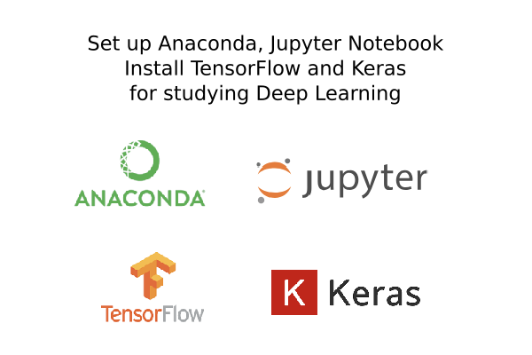

Slide 81
Hardware for Machine Learning –
a New Type of Challenge for Processing

Slide 82
Massive amount of computing performance is needed to train the sophisticated deep neural networks that power applications like :
Real-time speech translation, Autonomous robots, Detection of human emotions through facial analysis etc.
Training can take days to weeks on even the fastest supercomputers.

Slide 83
Deep learning involves huge amount of matrix multiplications and other operations which can be massively parallelized and can be sped up on GPUs
GPUs are optimized for matrix calculations resulting in faster training with the order that is 50 times faster
Modern GPUs are very efficient at manipulating computer graphics and image processing.

Slide 84
A single GPU might have thousands of cores(parallel processors) while a CPU usually has no more than 12 cores.
Although GPU cores are slower than CPU cores, but because of their large number and faster memory the operations can be parallelized.
Sequential code is still faster on CPUs.

Slide 85
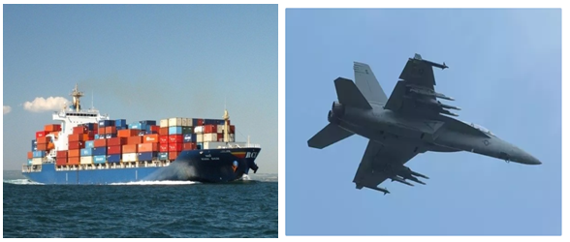
CPU vs GPU
GPU: Can work with tons of data, like cargoship Ship
CPU : Jet can bring one small block of cargo fast enough, but it takes weeks to carry thousands.
Each one is good for its own tasks, but not efficient for others.

Slide 86
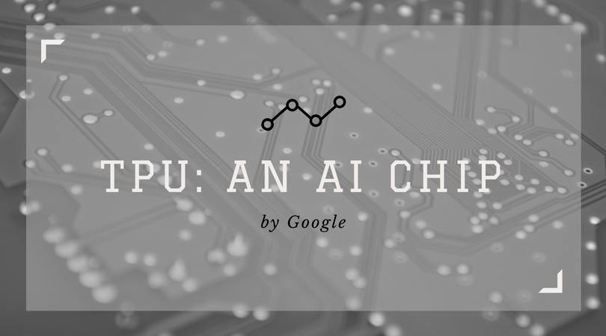
A Tensor Processing Unit (TPU) is an AI accelerator ASIC( application-specific integrated circuit) developed by Google in 2017 specifically for machine learning , used by its many of the services like google street view, google search, or google photos

Slide 87
Key GPU manufacturers :
Nvidia (first GPU geForce256), AMD(advanced micro devies), Intel, Tesla, Amazon Web Services (AWS), Baidu, Arm, Apple , IBM, Xilinx, Amazon etc.
best CPUs have about 50GB/s while the best GPUs have 750GB/s memory bandwidth
(rate at which data can be read from or stored into a semiconductor memory by a processor)

Slide 88
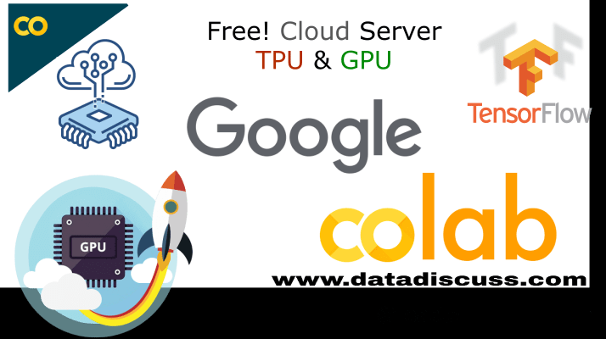
Google Colab is a widely popular cloud service for machine learning that features free access to GPU and TPU computing.

Slide 89
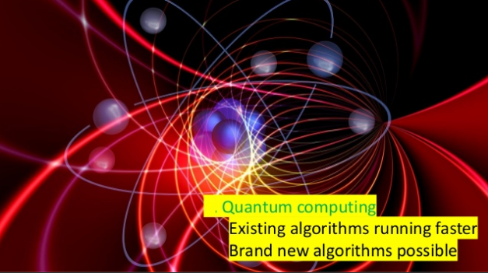

Slide 90
Data :
The Fuel Powering AI & Digital Transformation
Data is the fuel and
Analytics (“multi-disciplinary approach to derive insights from data),is the engine of new economy
--Oliver Schabenberger, CTO of SAS(Statistical Analysis Systems) Institute

Slide 91
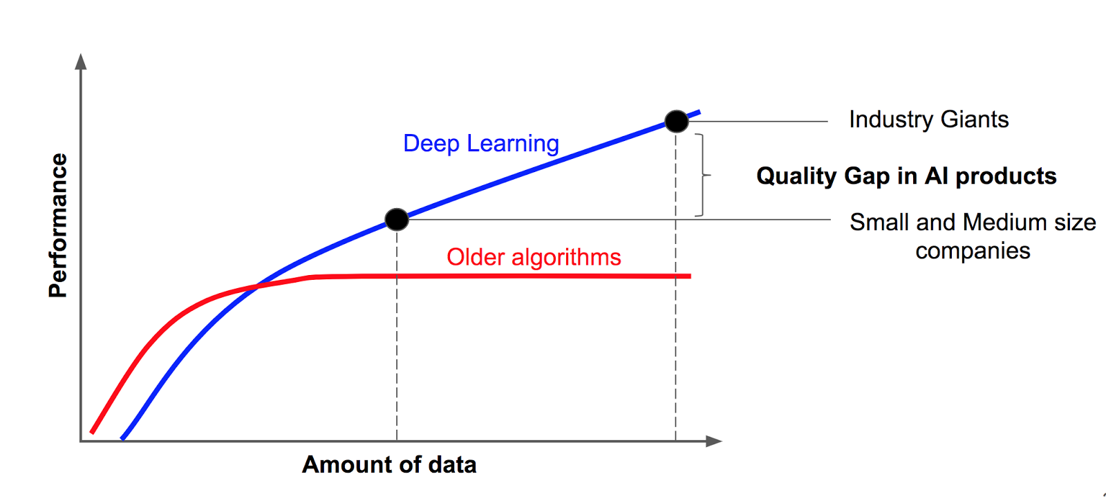
Andrew Ng Explains importance of data
What do you conclude ??

Slide 92
Conclusion 0: AI products need data.
Conclusion 1: more data we have — the smarter AI will be.
Conclusion 2: quality gap in AI products is defined by amount of data
Companies which focused on data gathering provide better AI products and are hugely successful.

Slide 93
The core of deep learning is that we now have fast enough computers and enough data to actually train large neural networks.
most flavors of the old generations of learning algorithms … performance will plateau. … deep learning … is the first class of algorithms … that is scalable. … performance just keeps getting better as you feed them more data Andrew Ng

Slide 94
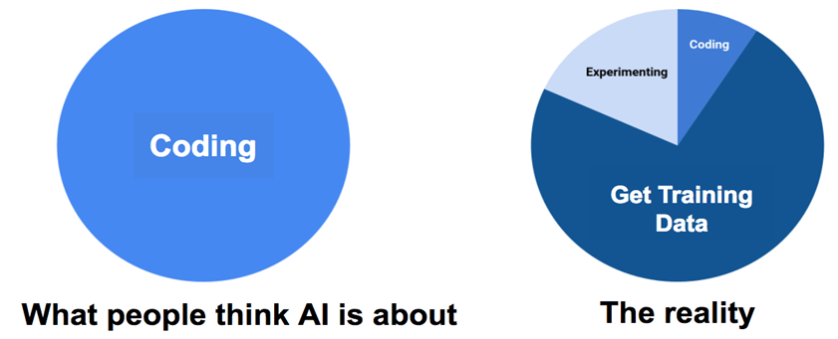
Network architecture can strongly influence the performance of an AI system, yet
the amount of training data has biggest impact on performance.

Slide 95
Algorithms are free: Google and other giants tend to share their state-of-the-art research with the world, but what they don’t — they don’t share data. industry giants have much more data than others.
“When data is monetised, it becomes toxic and harms public interest”

Slide 96
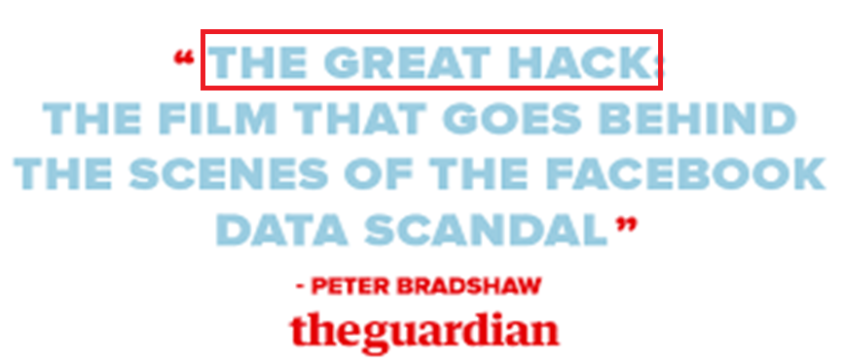
The Facebook–Cambridge Analytica data scandal was a major political scandal in early 2018 when it was revealed that Cambridge Analytica had harvested the personal data of millions of peoples' Facebook profiles without their consent and used it for political advertising purpose

Slide 97
Sources of Training data
Open-sourced datasets.
Artificial data.
Web. It is hard to automatically collect high quality training data. Most likely that human should correct and filter it.
Order image annotation from someone. There are some companies that provide such services
Annotate images by hands :Only you understand your task. Domain expertise is crucial. Medical image annotation is a good example: only doctor knows where tumor is.

Slide 98
Dataset Finders
Kaggle: Kaggle provides a vast container of datasets, sufficient for the enthusiast to the expert.
UCI Machine Learning Repository: The Machine Learning Repository at UCI provides an up to date resource for open-source datasets.
VisualData: Discover computer vision datasets by category; it allows searchable queries.
CMU Libraries: Discover high-quality datasets thanks to the collection of Huajin Wang, at CMU.
The Deep Learning Toolbox™ of matlab contains a number of sample data sets that you can use to experiment with shallow neural networks.

Slide 99
General Datasets:
Datasets for Recommender Systems
Clinical Datasets
Self-driving (Autonomous Driving) Datasets
Natural Language Processing (NLP) Datasets
Sentiment Analysis Datasets
Computer Vision Datasets
Fake news detection dataset etc. etc.

Slide 100
MNIST(Modified National Institute of Science & Technology) This is a dataset of 60,000 , 28x28 grayscale images of the handwritten 10 digits, along with a test set of 10,000 images.
CIFAR (Canadian Institute For Advanced Research)
CIFAR-10 is an established computer-vision dataset used for object recognition. It consists of 60,000, 32x32 color images containing one of 10 object classes, with 6000 images per class. It was collected by Alex Krizhevsky, Vinod Nair, and Geoffrey Hinton.
ImageNet: The de-facto image dataset for new algorithms, more than 20,000 categories.
ImageNet consists of over 14 million images organized into 21,841 subcategories. On average, there are over 500 images per subcategory

Slide 101
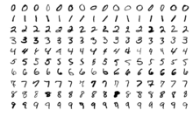
MNIST Database
The MNIST database is a large database of handwritten digits that is commonly used for training various image processing systems.
The MNIST database contains 60,000 training images and 10,000 testing images.

Slide 102
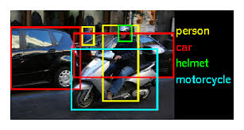
ImageNet
Over 14 million URLs of images have been hand-annotated by ImageNet to indicate what objects are pictured and in at least one million of the images, bounding boxes are also provided.
ImageNet contains over 20 thousand categories, such as "balloon" or "strawberry“,contains several hundred images.

Slide 103
END

